Slide 1
Arrays In Java
momedaram

Slide 2
Array is a set of values where each value is identified by an index.
The index of an array starts from 0.
we can make an array of int , double, boolean or any other types but all the values of array must be of same type.
int[] employeeNumbers;
float[] salaries ;
long[] x;
String[] names;

Slide 3
Declaring Arrays In Java :
DataType[] variableName;
DataType variableName[];
int[] employeeNumbers; float salaries[] ;
long x[]; String[] names;
Both styles of declaring arrays in java are valid but the style DataType[] variableName is preferred.

Slide 4

Instantiating An Array Object :
array in java is an object hence we can create by using new operator.
int[] employeeNumbers = new int[10]; float[] salaries = new float[10];
long[] x ;
x = new long[10];
Size
Size can’t be negative

Slide 5
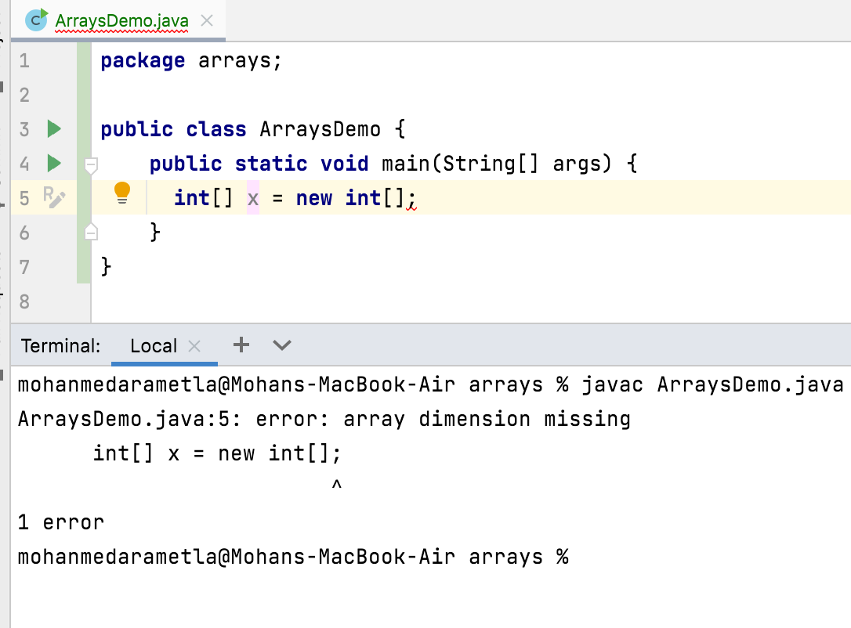

Slide 6
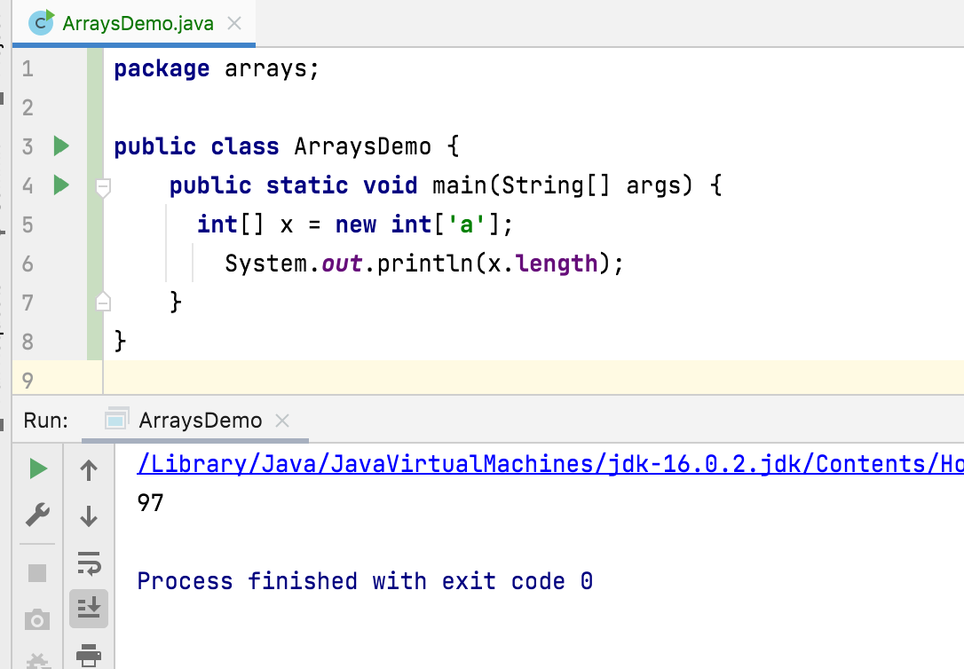
int[] x = new int['a’];
Can we declare like this ?

Slide 7
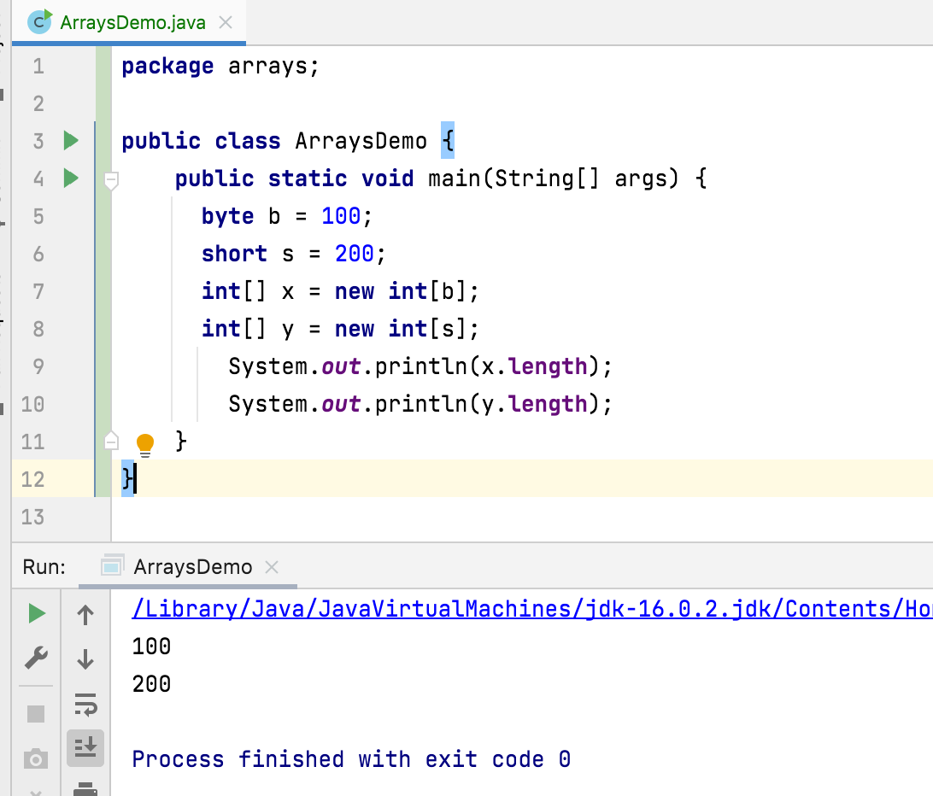
byte b = 100; short s = 200; int[] x = new int[b]; int[] y = new int[s];
Can we declare like this ?
The allowed data types to specify array size are byte, short, char, int.
Size → 2147483647

Slide 8



How Are the Arrays stored in the memory?
When we create an array object of specified type and length with new operator, by default all array elements in the array object are initialized with default values.
int[] x = new int[10];
2 5
we can not insert or delete array elements after creating an array. Only we can change is the value of the elements.
x[0] = 2; x[3] = 5;
0 0 0 0 0 0 0 0 0 0
x

Slide 9
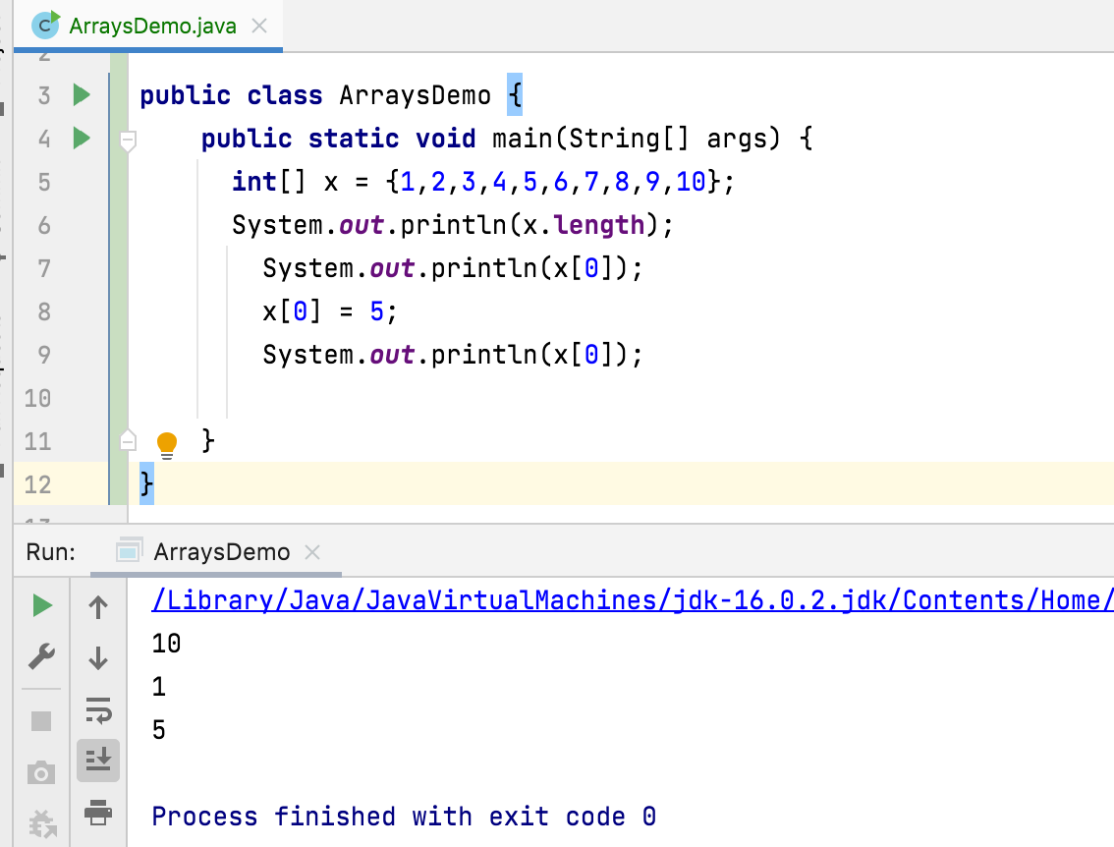

Slide 10
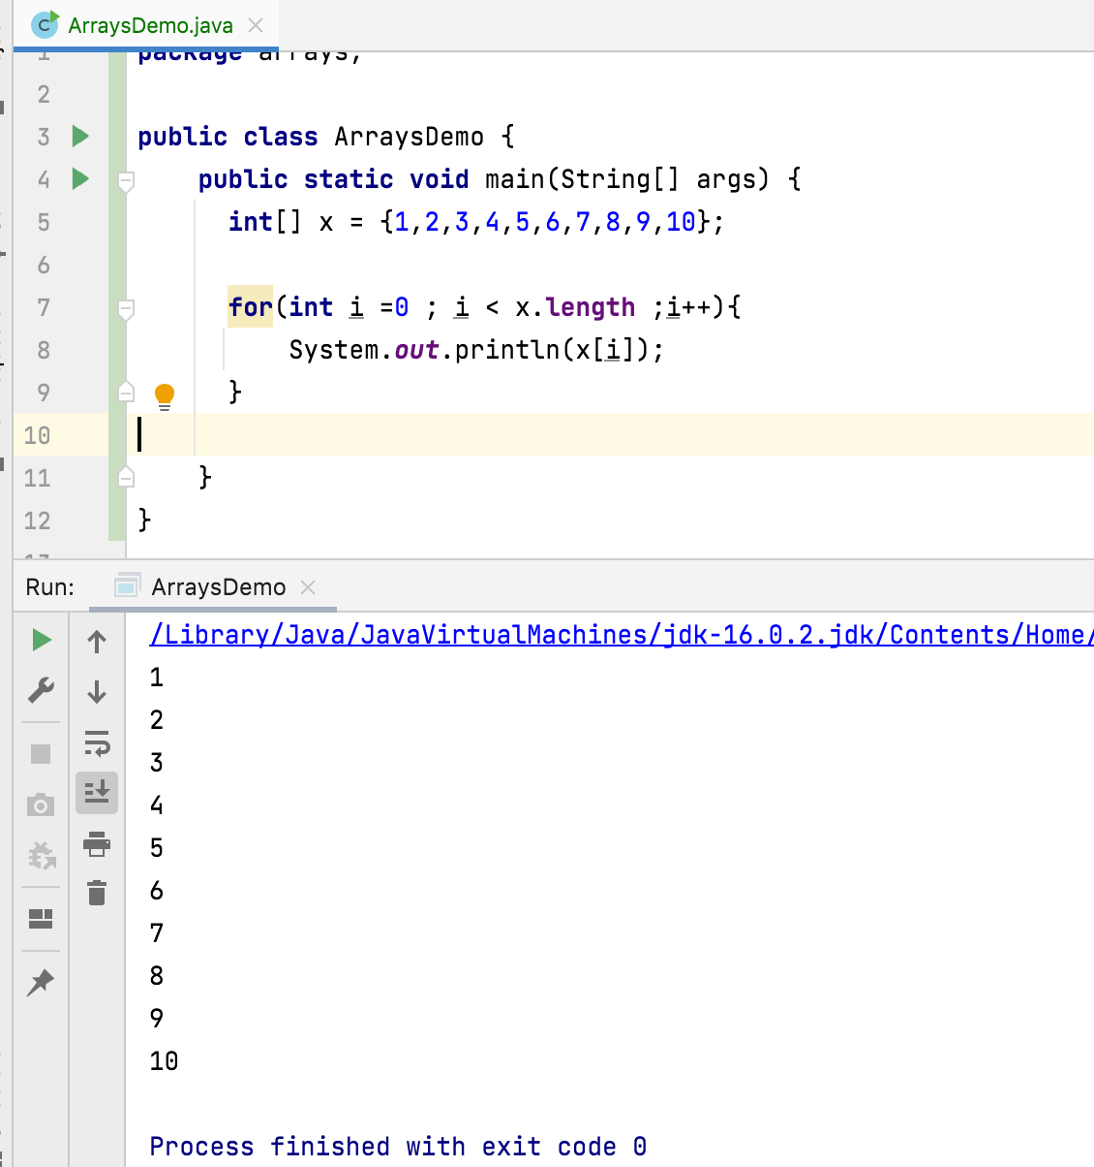
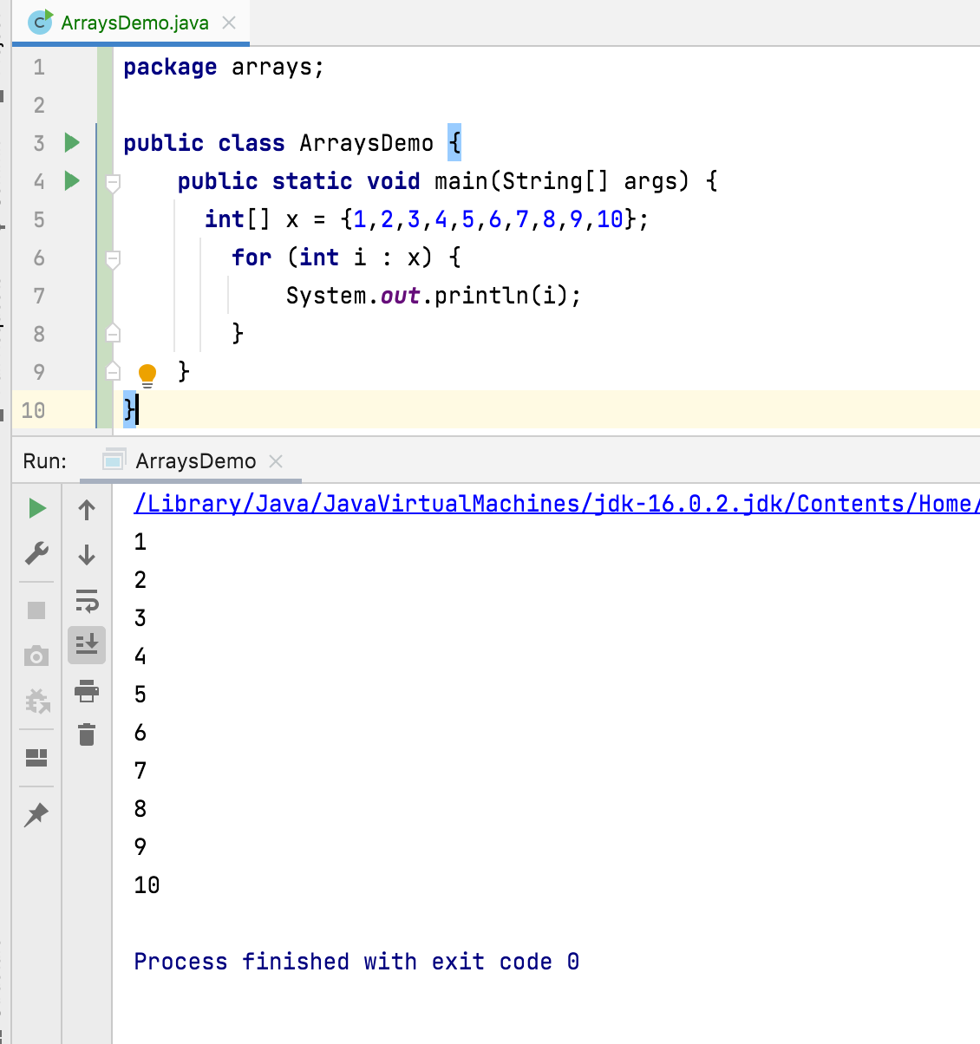

Slide 11
Thank You !
momedaram

